Slide 1

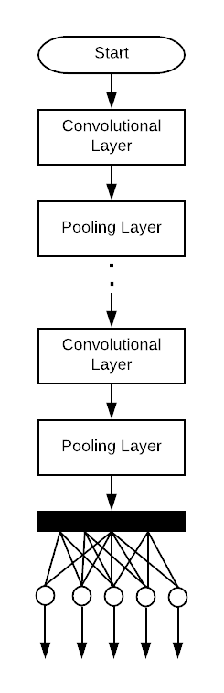
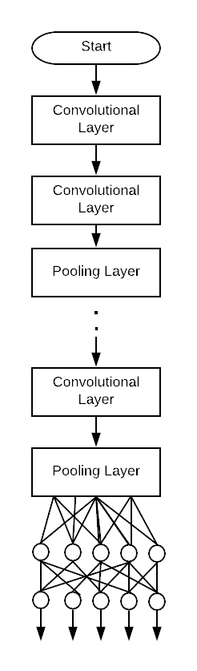
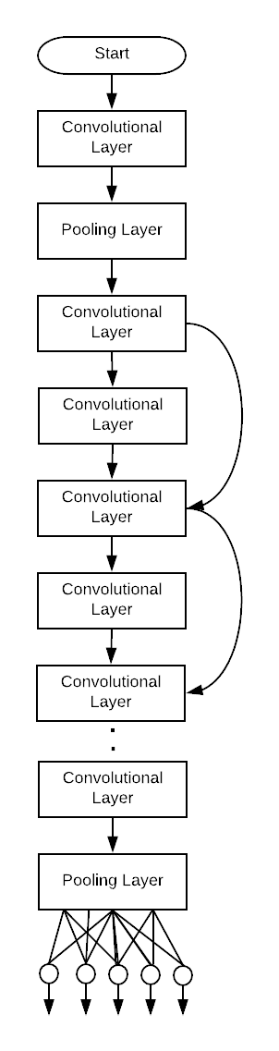
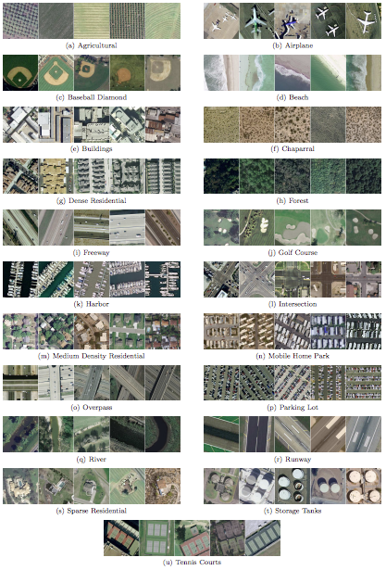
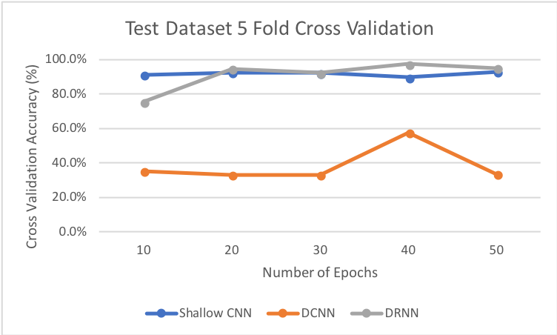
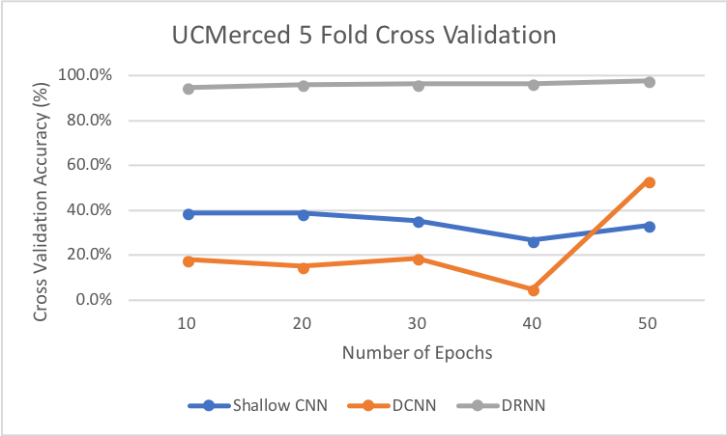
Comparison of Convolutional Neural Networks
for Remote Sensing
James Hurt
Abstract
Method
The goal of this project was to investigate how deep learning compares to non-deep learning, and ultimately to compare how 3 separate Remote Sensing tools perform during 5 fold cross validation. The three techniques chosen for comparison are: Shallow Convolutional Network, Deep Convolutional Network, and a Deep Residual Network. Two datasets were used for experimentation, one being a 3 class problem and the other being the UC Merced Benchmark Dataset [1], which is comprised of 21 classes with 100 training examples each.
Training
Train each method on both datasets for 10, 20, 30, 40, and 50 epochs with a batch size of 16, using SGD optimizer and categorical cross-entropy loss
Model Configuration
Shallow CNN: 5 Conv. Layers, 5 pooling layers, 32 filters, 3x3 Kernel, 2x2 Max Pooling with 1 fully connected softmax layer
DeepCNN: VGG19 [2], which has 16 convolutional layers with Max Pooling and 3 fully connected layers, the last of which being a softmax layer
DeepRNN: ResNet50 [3], which has 50 residual layers with Max Pooling and 1 fully connected softmax layer
Shallow CNN
VGG19
ResNet50
UC Merced Dataset
Tech Stack
Results
References
Test Dataset
UCMerced Dataset
[1] Y. Yang and S. Newsam, “Bag-of-visual-words and spatial extensions for land-use classification,” 2010, p. 270.
[2] K. Simonyan and A. Zisserman, “Very Deep Convolutional Networks for Large-Scale Image Recognition,” arXiv:1409.1556 [cs], Sep. 2014.
[3] K. He, X. Zhang, S. Ren, and J. Sun, “Deep Residual Learning for Image Recognition,” arXiv:1512.03385 [cs], Dec. 2015.
Method | 10 | 20 | 30 | 40 | 50
Shallow CNN | 91.2% | 92.5% | 92.2% | 89.7% | 92.8%
Deep CNN | 35.1% | 33.1% | 33.1% | 57.7% | 33.5%
Deep RNN | 75.5% | 94.5% | 92.3% | 97.3% | 94.9%
Method | 10 | 20 | 30 | 40 | 50
Shallow CNN | 38.9% | 38.6% | 35.3% | 26.6% | 33.2%
Deep CNN | 17.9% | 15.1% | 18.6% | 4.9% | 53.1%
Deep RNN | 94.8% | 96.2% | 96.2% | 96.4% | 97.8%

